Slide 1
Week 3 Checkerboard Assignment (Redo)
Shane Pratt
EMBD.X424
AI-Driven Embedded Systems

Slide 2
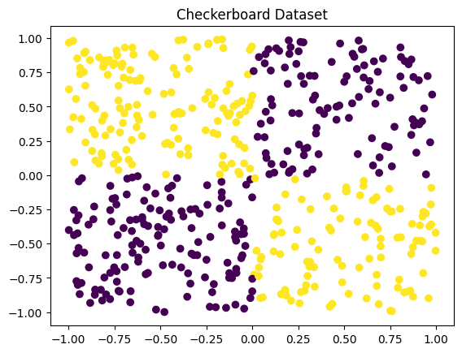
Checkerboard – 2x2
1 hidden layer
Hidden layer size = 8
LR = 0.1
Epochs = 1000

Slide 3
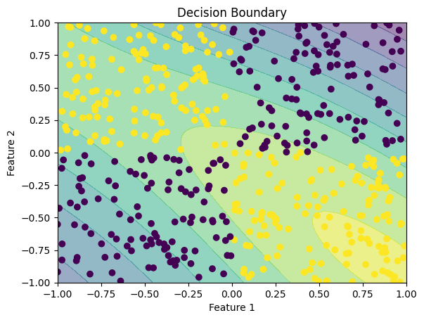
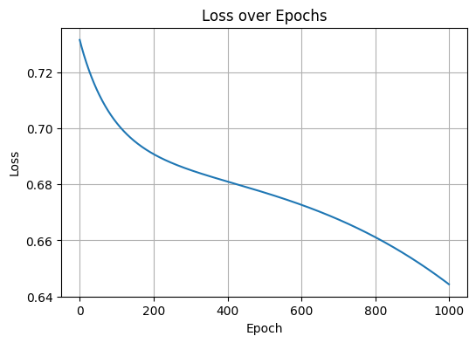
Checkerboard – 2x2

Slide 4
Checkerboard – 2x2
Improvements
Model Architecture
Increase hidden layers/neurons
Different activation functions – ReLU for hidden layers
Training Process Improvements
Hyperparameter Tuning – change learning rate, number of epochs, etc
Mini-Batch Gradient Decent – train smaller subsets of data
Regularization – L1/L2 regularization technique to prevent overfitting
Data-Related Improvements
More data
Feature Scaling/Normalization (I don’t think this is applicable)

Slide 5
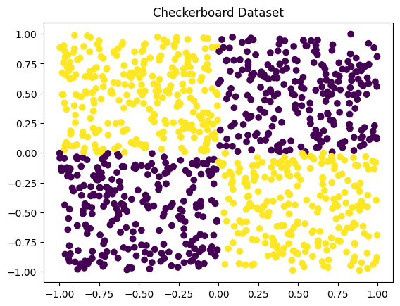
Checkerboard – 2x2 (Improvement 1)
Doubled number of samples
Adjusted initialization weights*
initial weights were too small, lead to 'dying ReLUs' where many neurons output zero
2 hidden layers
Hidden layer size = 32, 16
LR = 0.01
Epochs = 5000

Slide 6
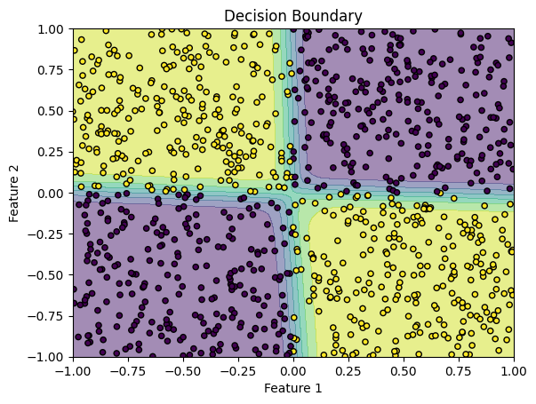
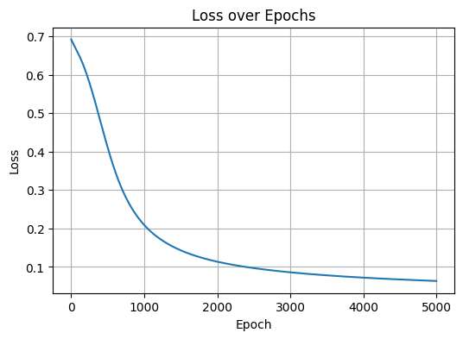
Checkerboard – 2x2 (Improvement 1)
Epoch 4900, Loss: 0.0641

Slide 7
Checkerboard – 2x2 (Improvement 1)
Mini-batch gradient decent
2 hidden layers
Hidden layer size = 32, 16
LR = 0.01
Epochs = 5000
Batch size = 64

Slide 8
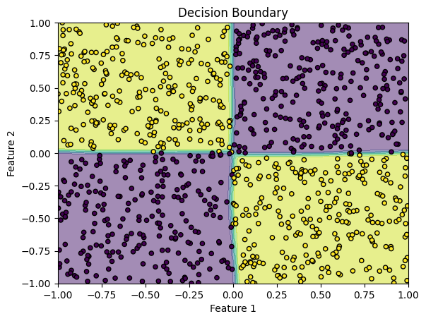
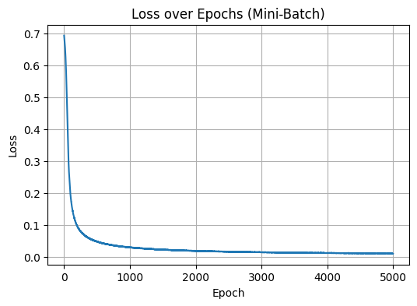
Checkerboard – 2x2 (Improvement 2)
Epoch 4900, Loss: 0.0106
Notes:
Full-Batch Model Accuracy: 0.9960 (or 99.6%)
Mini-Batch Model Accuracy: 1.0000 (or 100%)

Slide 9
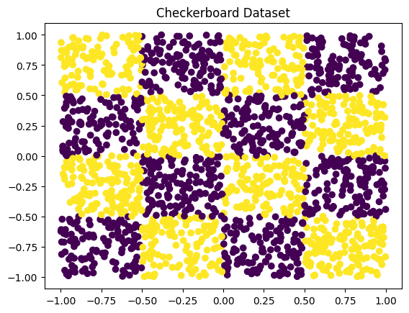
Checkerboard – 4x4
Adjustments
Increased learning rate from 0.1 to 0.5
Increased to 3 hidden layers
Sizes = 64, 32, 16

Slide 10
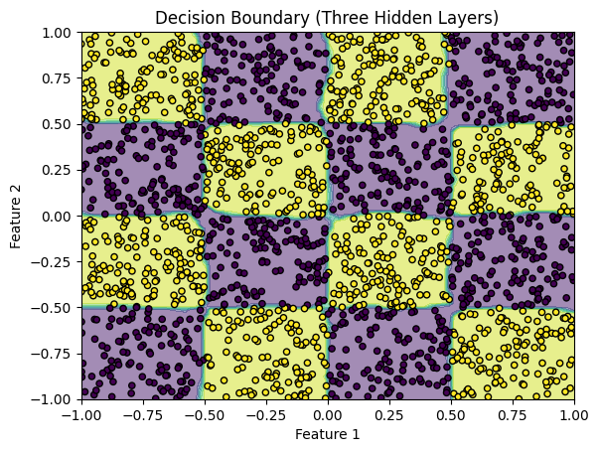
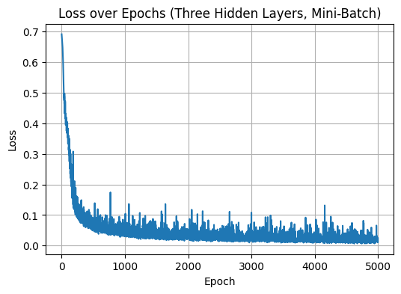
Checkerboard – 4x4
Epoch 4900, Loss: 0.0100
Notes:
Three-Hidden-Layer Mini-Batch Model Accuracy: 0.9950

Slide 11
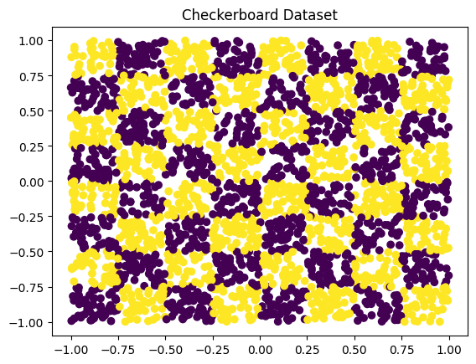
Checkerboard – 8x8
Adjustments
none

Slide 12
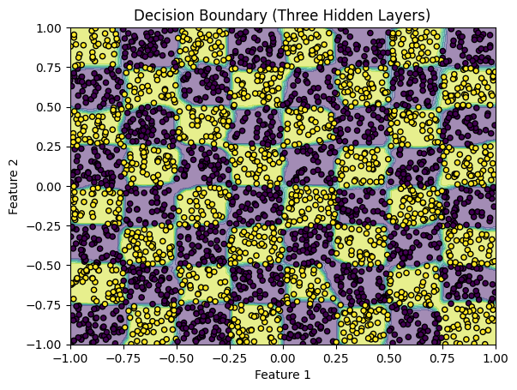
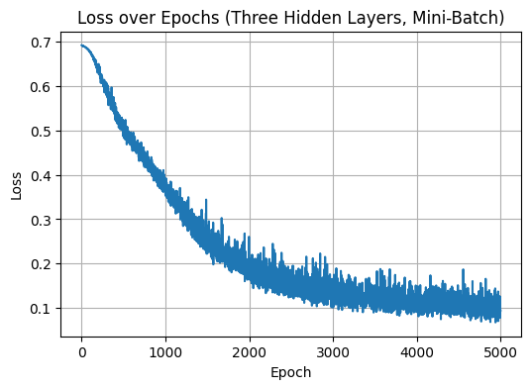
Checkerboard – 8x8
Epoch 4900, Loss: 0.1110
Notes:
Three-Hidden-Layer Mini-Batch Model Accuracy: 0.9667

